Slide 1
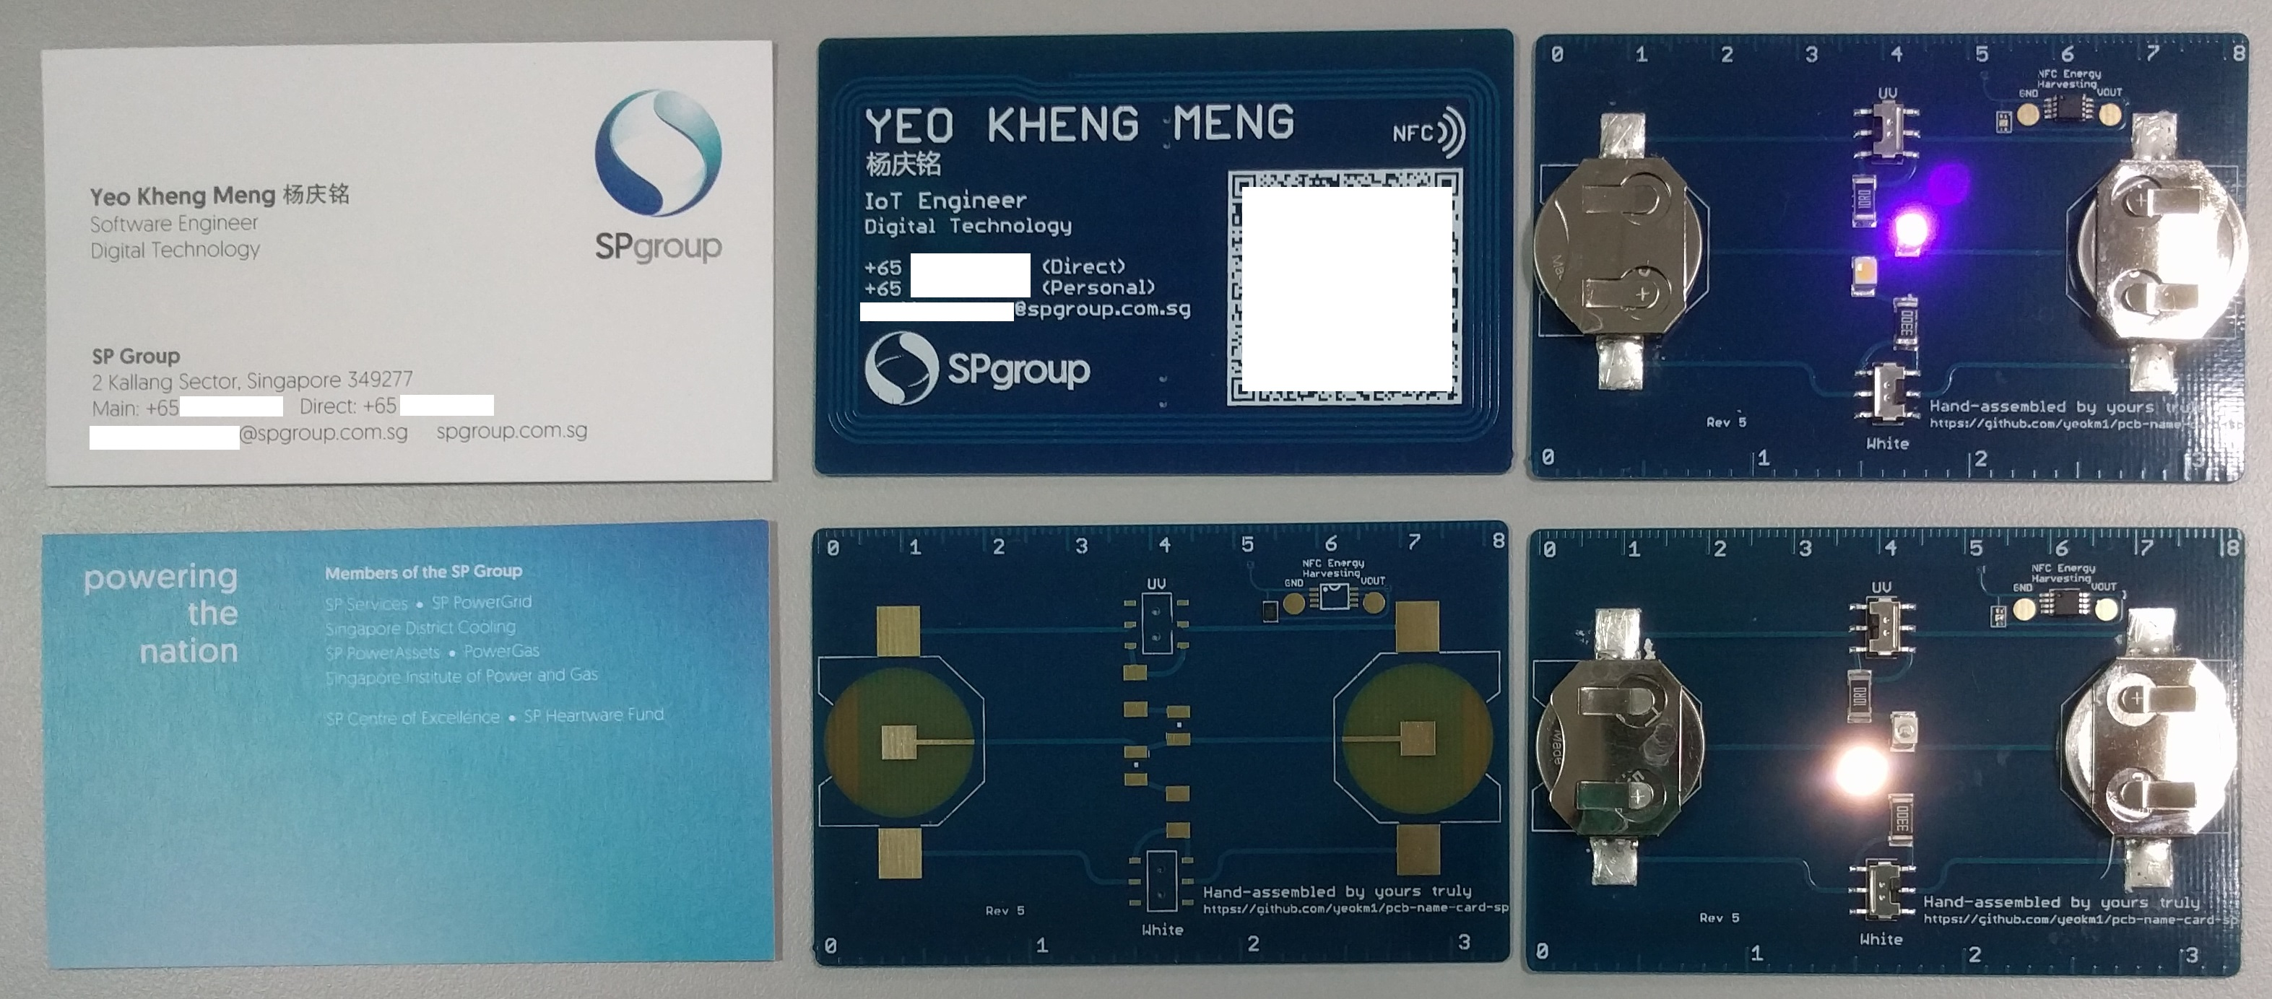
PCB Business Card (SP)
SP Digital Tech Talk (18 May 2017)
Hackware v1.5 (24 Feb 2016)
By: Yeo Kheng Meng (yeokm1@gmail.com)
https://github.com/yeokm1/pcb-name-card-sp

Slide 2
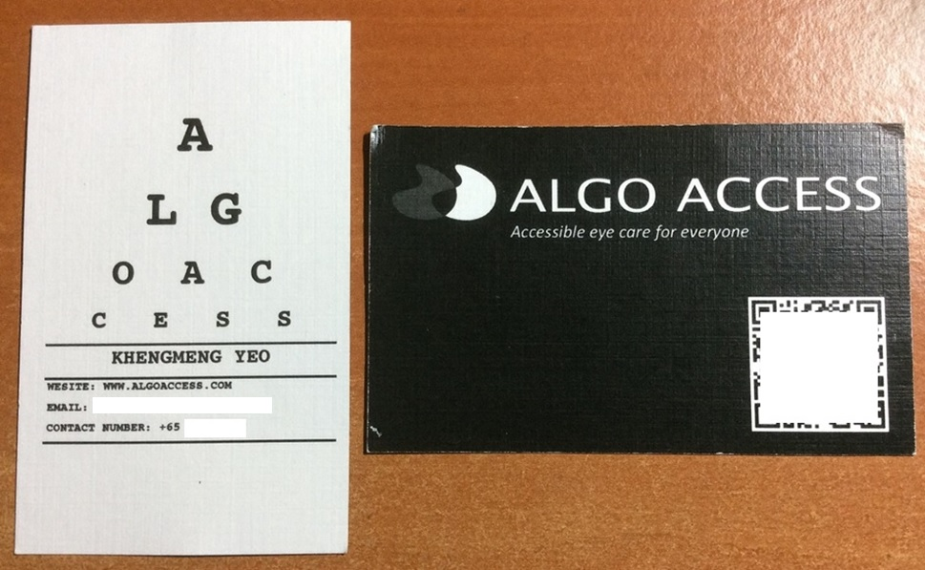
Backstory June 2015
The spelling mistake

Slide 3
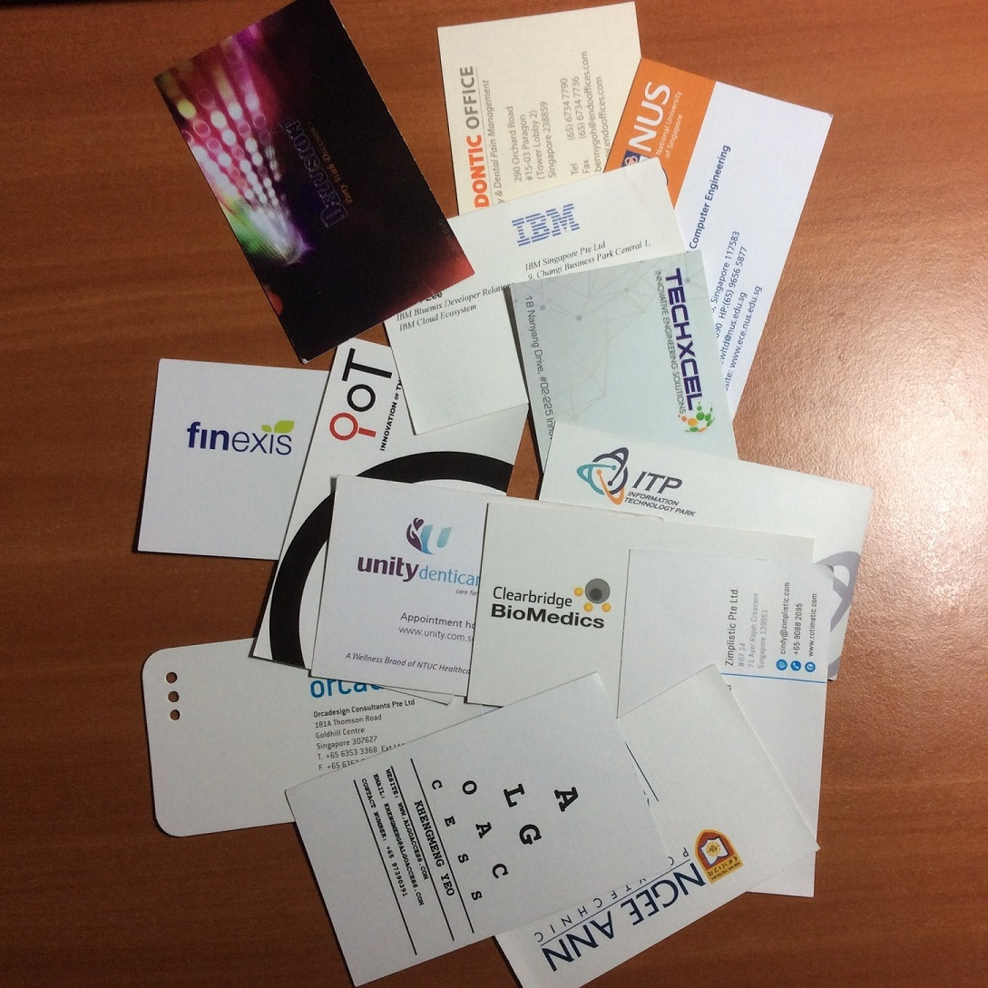
Typical business cards

Slide 4
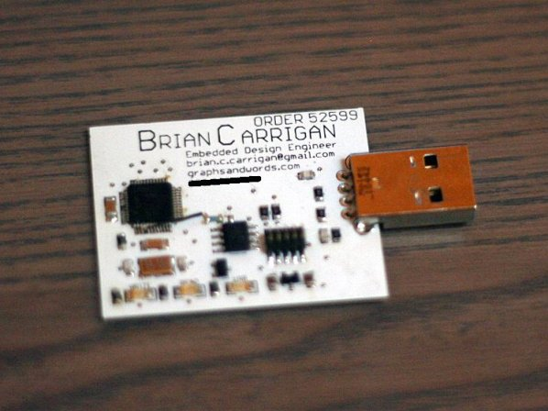
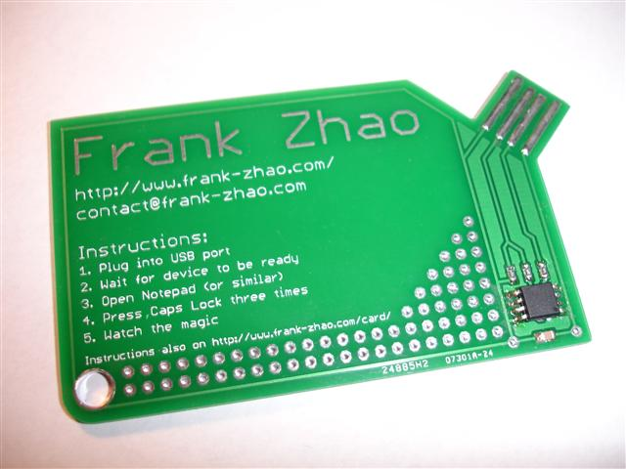
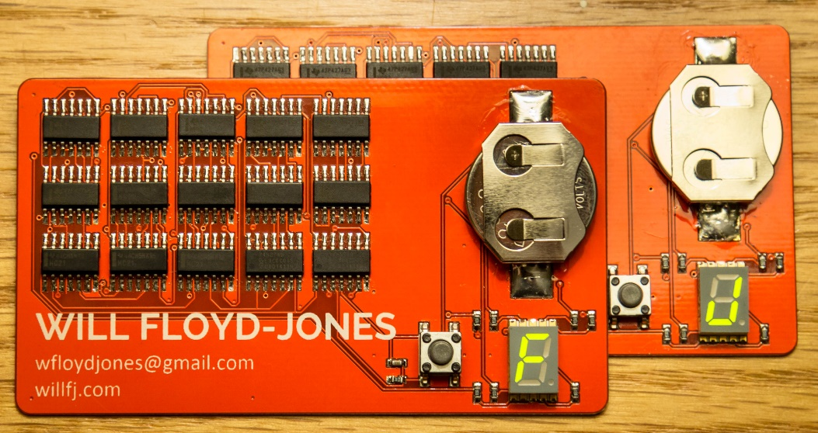
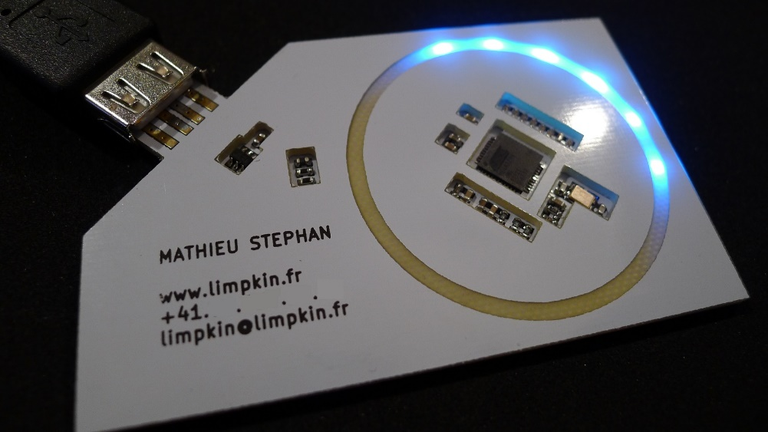
Existing PCB business cards
Flash Drive emulation: http://makezine.com/2012/08/22/pcb-business-card-2/
USB keyboard entry: http://eleccelerator.com/usb-business-card/
Logic gates: http://willfj.com/pcb-business-card/
Light ring: http://www.limpkin.fr/index.php?post/2014/06/16/My-business-card-v2

Slide 5
Goals of my business card
Be different
Be useful
Appear classy but not too expensive

Slide 6
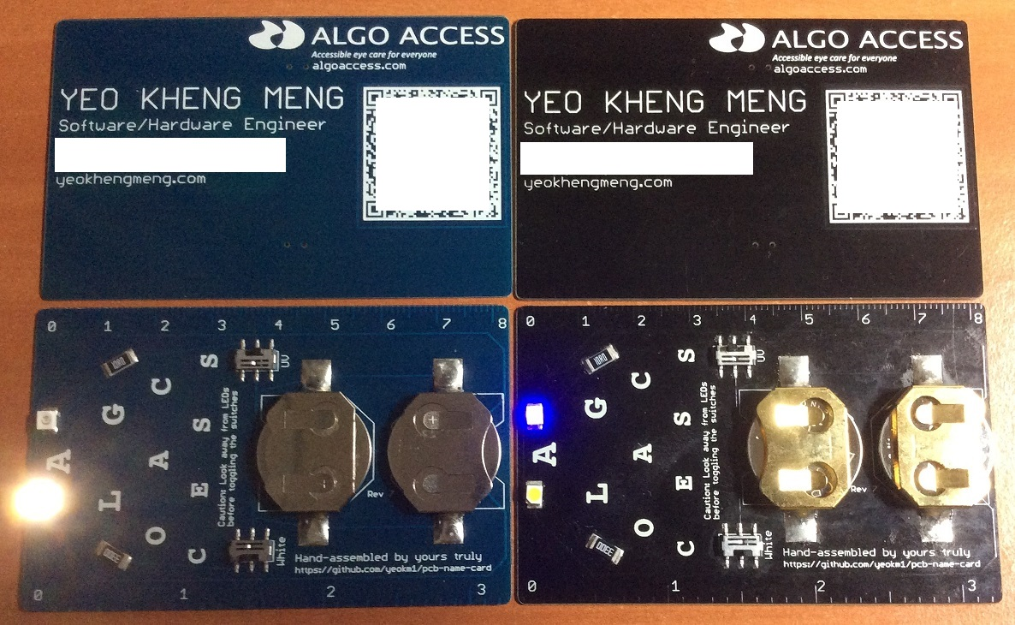
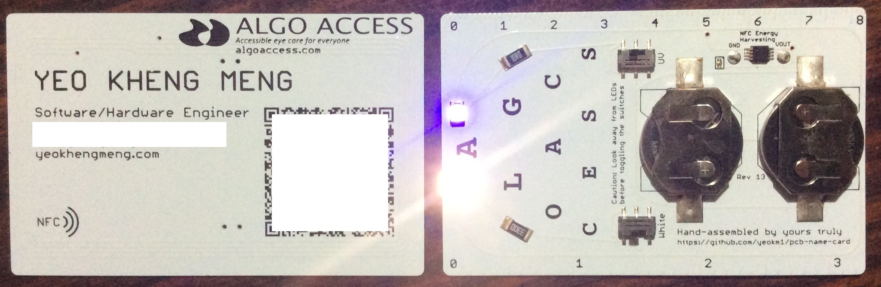
My previous name cards

Slide 7
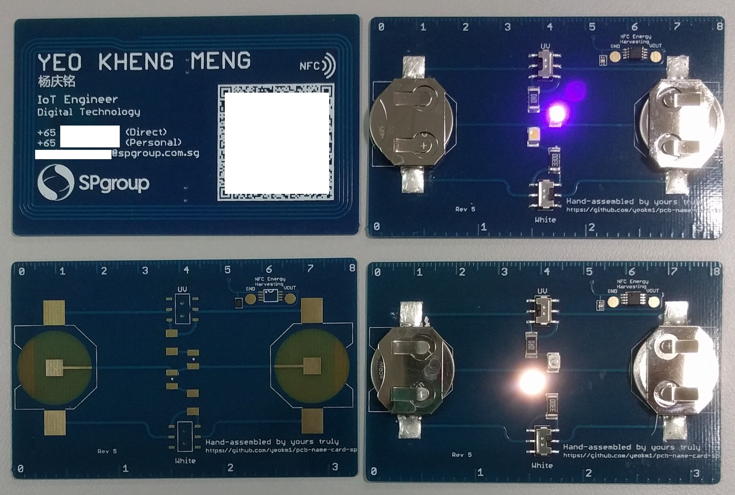
Feature goals
2 versions
Thin low cost
Thick high cost
Surface-mounted components
White LED
Ultraviolet LED
Slide Switches
Quick adding of my contact
QR code
Near Field Communication (NFC)
Ruler

Slide 8
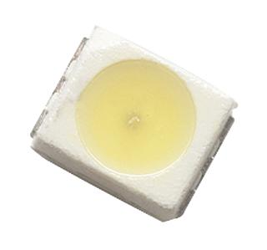
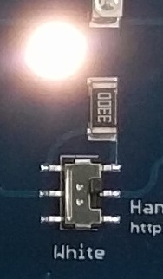
White LED (torch)
Avago Neutral White
PLCC-2 package (3.2 x 2.8 x 1.9mm)
Add 330 ohm resistor to ↓ current
1mA current

Slide 9
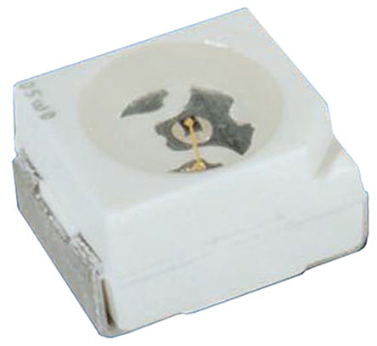
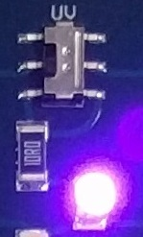
Ultraviolet LED
Vishay
PLCC-2 package (3.2 x 2.8 x 1.9mm)
405nm (near-UV)
Current usage ~3mA

Slide 10
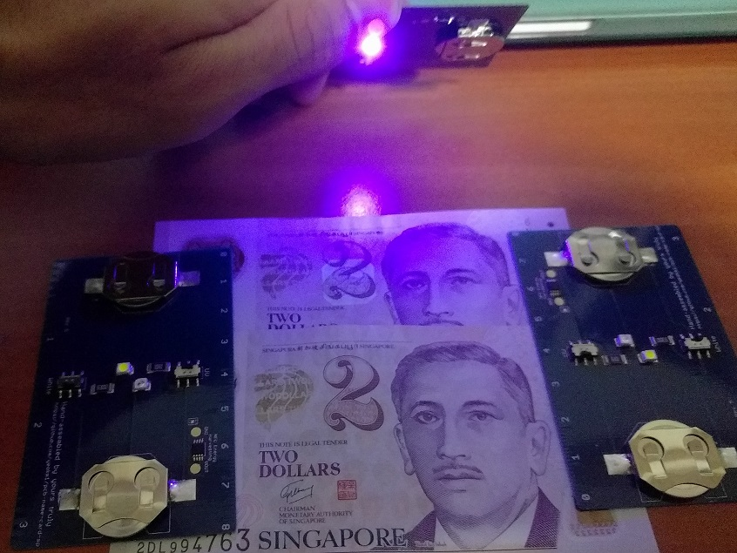
UV LED in action

Slide 11
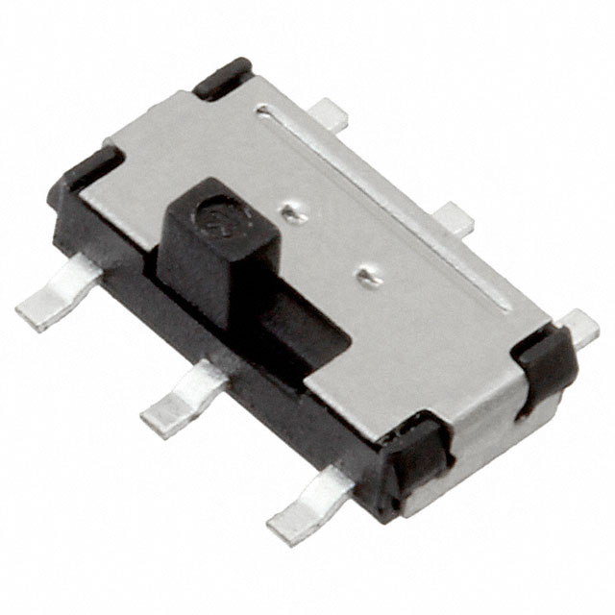
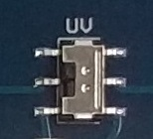
Switches
C&K Components DPDT Minature slide switch
3mm height

Slide 12
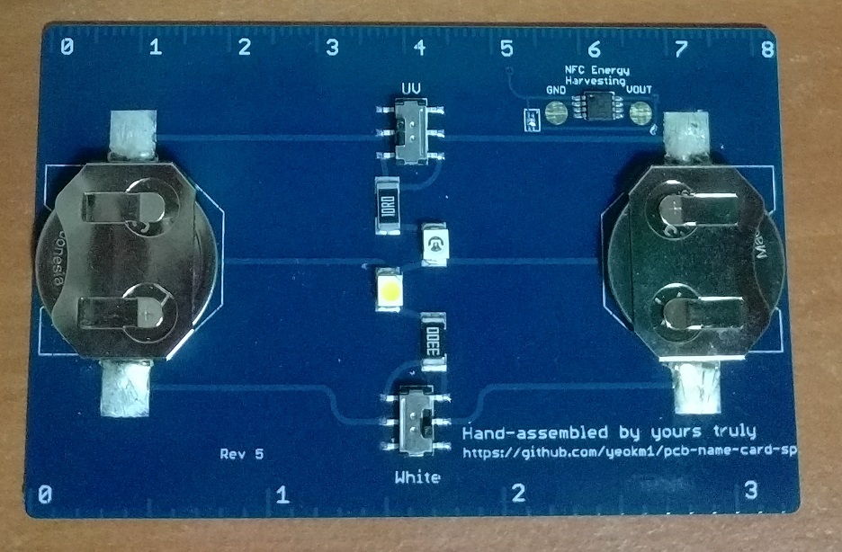
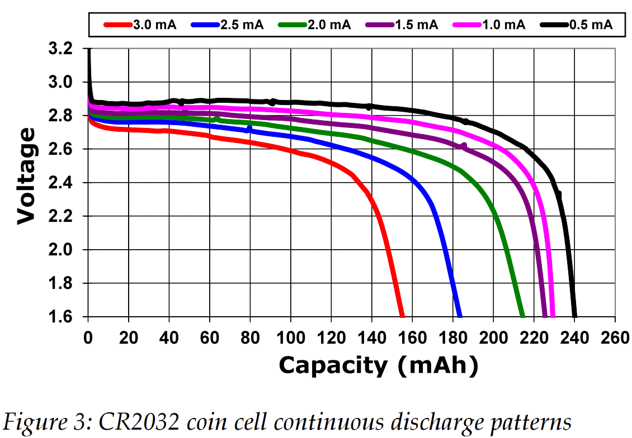
Why 2 batteries?
Coin cells connected in parallel to reduce current load
High currents reduce overall battery capacity
Two batteries results in >2x single battery life
Weight balance
Source:
Nordic Semiconductor, Sept 2011: High pulse drain impact on CR2032 coin cell battery capacity
http://m.eet.com/media/1121454/c0924post.pdf

Slide 13
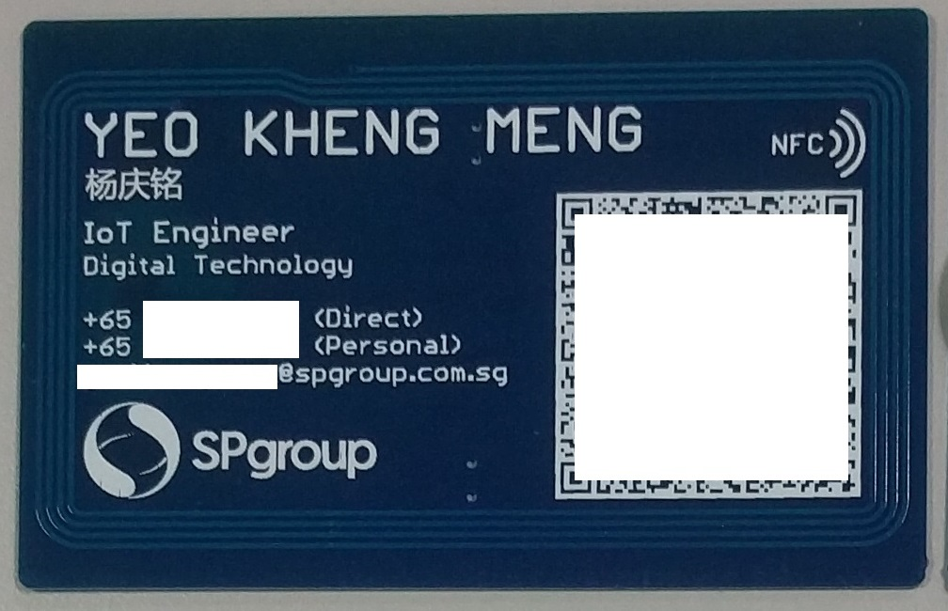
Quick contact adding 1: QR Code
QR code contains vCard
BEGIN:VCARD
VERSION:3.0
N:Yeo;Kheng Meng
TITLE:IoT Engineer
ORG:SP Group
EMAIL;type=INTERNET;type=WORK;:xxx@spgroup.com.sg
EMAIL;type=INTERNET;type=PERSONAL;:xxx@gmail.com
TEL;TYPE=WORK,VOICE:+65 0000000
TEL;TYPE=CELL,VOICE:+65 12345678
URL;WORK:https://www.spgroup.com.sg
URL:http://yeokhengmeng.com
URL:https://www.linkedin.com/in/yeokhengmeng
END:VCARD
iOS Demo

Slide 14
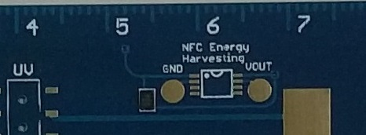
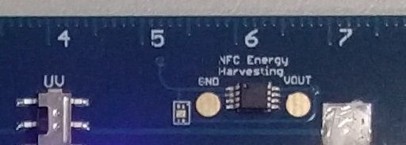
Quick contact adding 2: NFC
NFC chip contains vCard
Thin NFC chip on thin version
NXP NTAG216 (NT2H1611)
0.26mm height
HXSON-4/SOT1312-1 package (1.5mm x 2mm)
888 bytes
50pf input capacitance
Large NFC chip on thick version
NXP NTAG I²C (NT3H1201)
1.1mm height
TSSOP-8 package (5mm x 3mm)
1904 bytes
50pf input capacitance
Android Demo

Slide 15
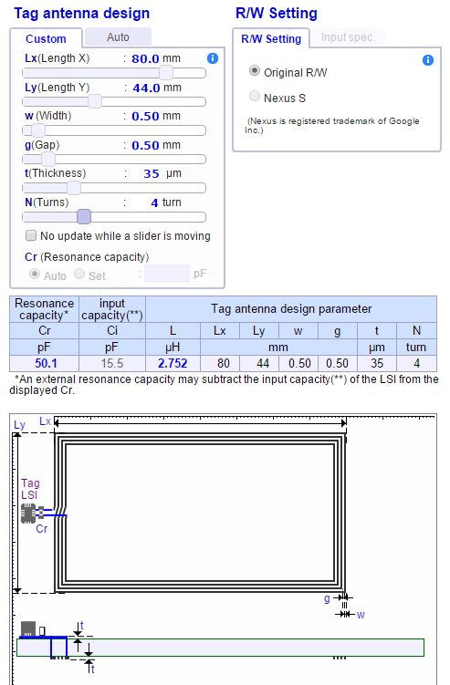
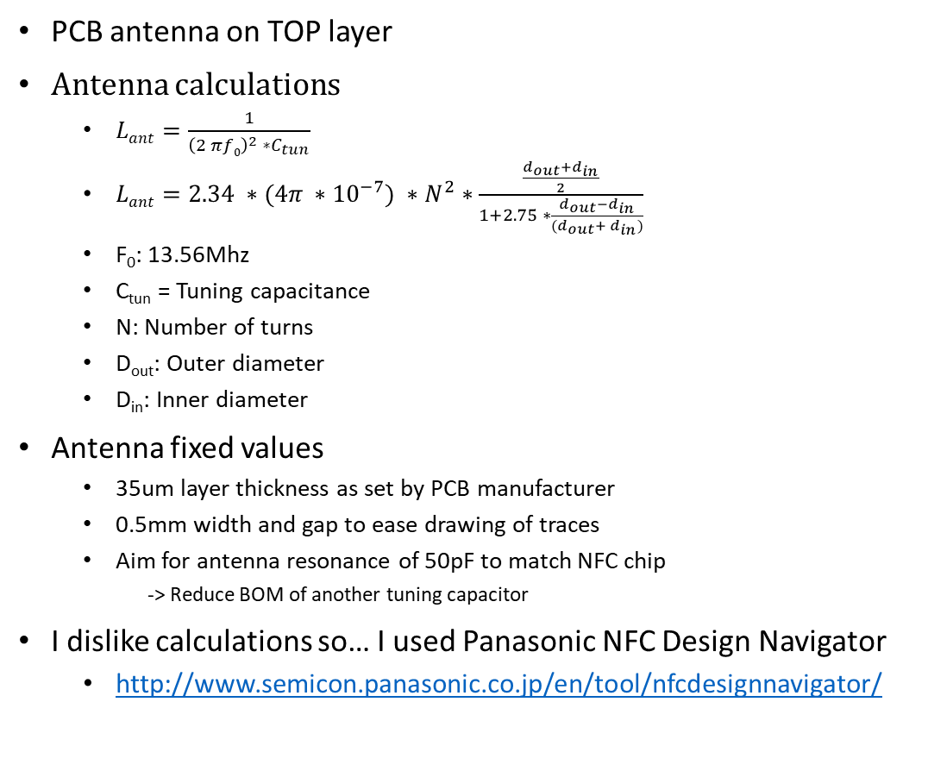
NFC Antenna Design
PCB antenna on TOP layer
Antenna calculations
$Lant=\frac{1}{{\left(2 πf0\right)}^{2} ∗C_{tun}}$
$Lant=2.34 ∗(4π ∗{10}^{−7}) ∗N^{2}∗\frac{\frac{d_{out}+d_{in}}{2}}{1+2.75 ∗\frac{d_{out}−d_{in}}{(d_{out}+ d_{in})}}$
F₀: 13.56Mhz
C_{tun} = Tuning capacitance
N: Number of turns
D_{out}: Outer diameter
D_{in}: Inner diameter
Antenna fixed values
35um layer thickness as set by PCB manufacturer
0.5mm width and gap to ease drawing of traces
Aim for antenna resonance of 50pF to match NFC chip
-> Reduce BOM of another tuning capacitor
I dislike calculations so… I used Panasonic NFC Design Navigator
http://www.semicon.panasonic.co.jp/en/tool/nfcdesignnavigator/
Antenna calculations source:
http://www.st.com/st-web-ui/static/active/jp/resource/technical/document/application_note/CD00221490.pdf

Slide 16
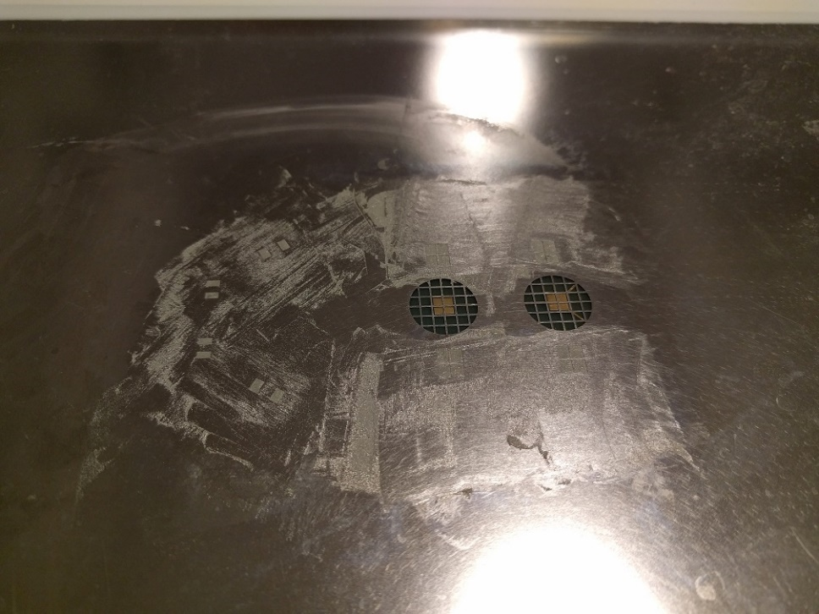
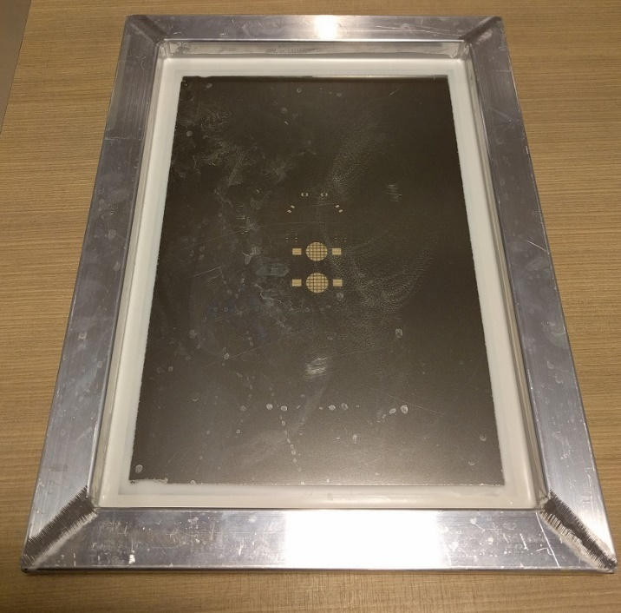
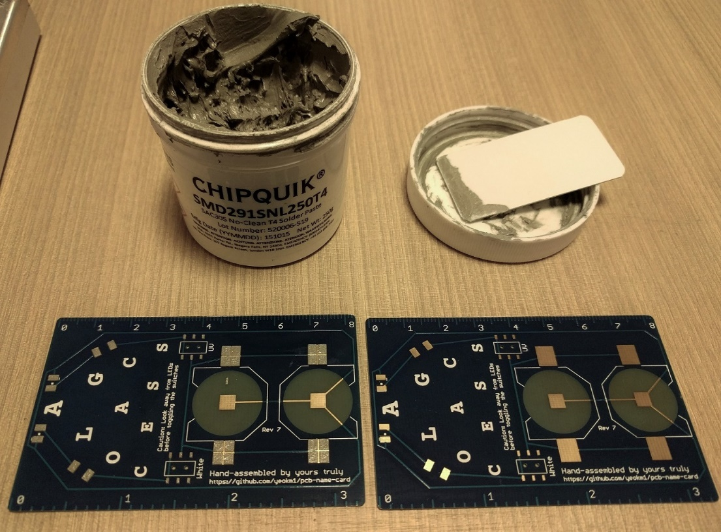
Assembly Process 1
Stencil and solder paste

Slide 17
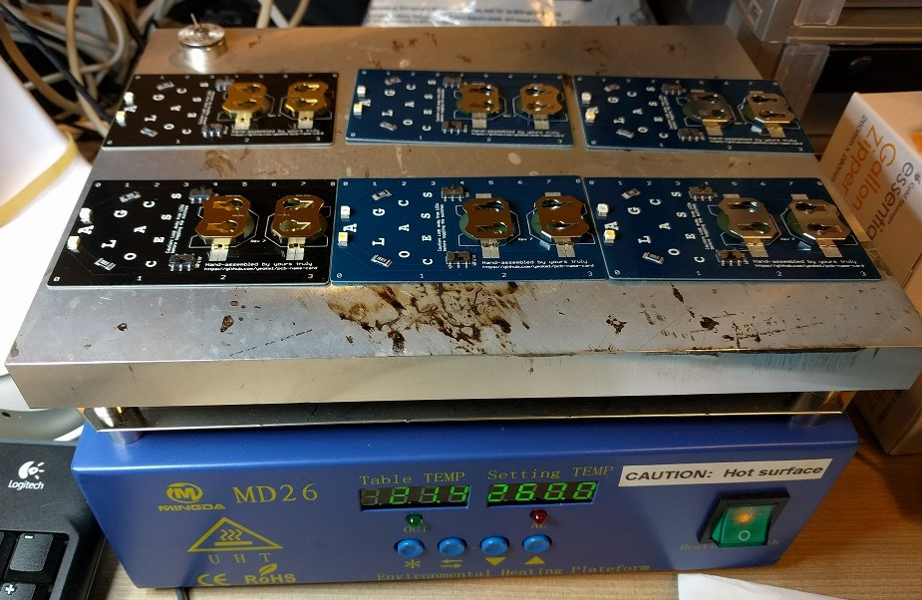
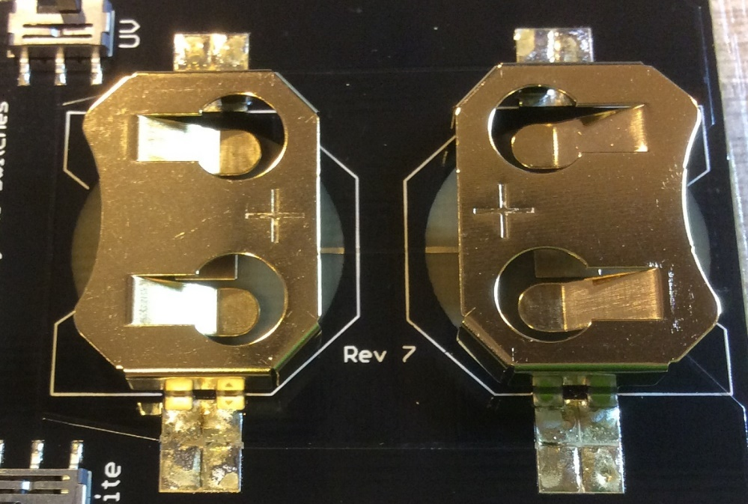
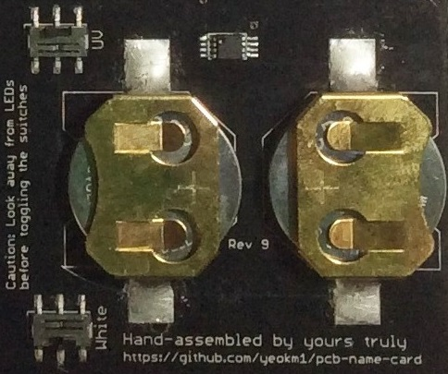
Assembly Process 2
Hot plate reflow soldering
Hand soldering for battery holders

Slide 18
Cost (SGD)
Pieces | Thin | Thick
10 | $7.73 | $15.53
50 | $3.74 | $10.53

Slide 19
Future work (Concept card)
Sensor suite
Bosch BME280: temperature/humidity/pressure sensor
Maxim MAX30100: Pulse Oximeter and Heart-Rate Sensor
Silicon Labs SI1145: UV Sensor
Texas Instruments TMP007: IR thermometer
OLED screen
Bluetooth Low Energy
Rigado BMD-300 or Raytac MDBT42 nRF52 module
LIR2450 3.6V rechargeable coin-cell
Microchip MCP73831 battery charging IC

Slide 20
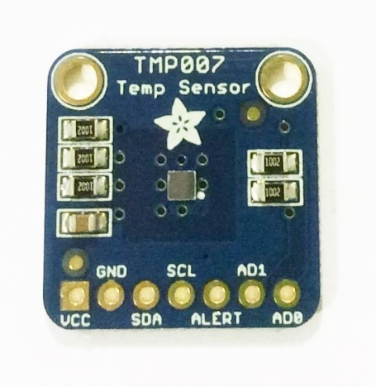
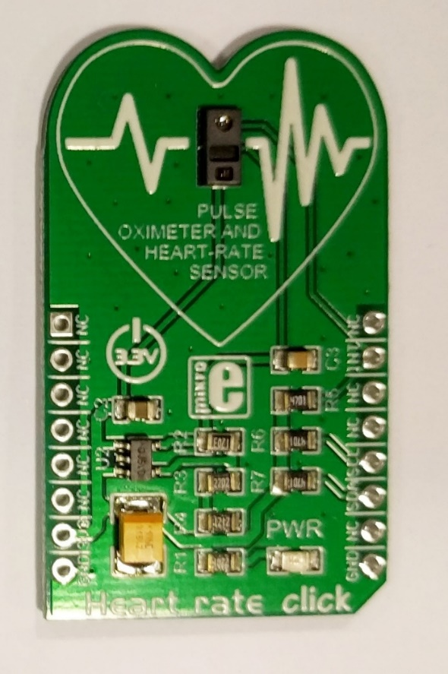
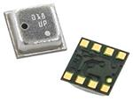
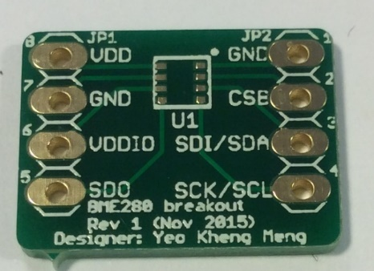
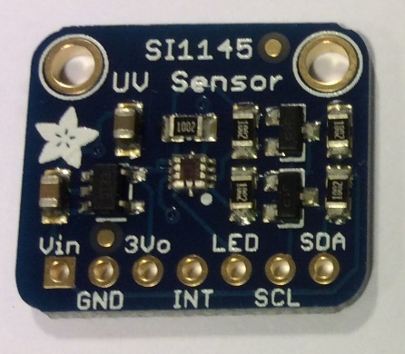
Sensor breakouts
TMP007 breakout
IR Thermometer
By Adafruit
Bosch BME280 breakout
Temperature & humidity
https://github.com/yeokm1/pcb-bme280-breakout
Maxim MAX30100 breakout
Pulse Oximeter & Heart-Rate Sensor
By MicroElektronika
SI1145 breakout
UV Sensor
By Adafruit

Slide 21
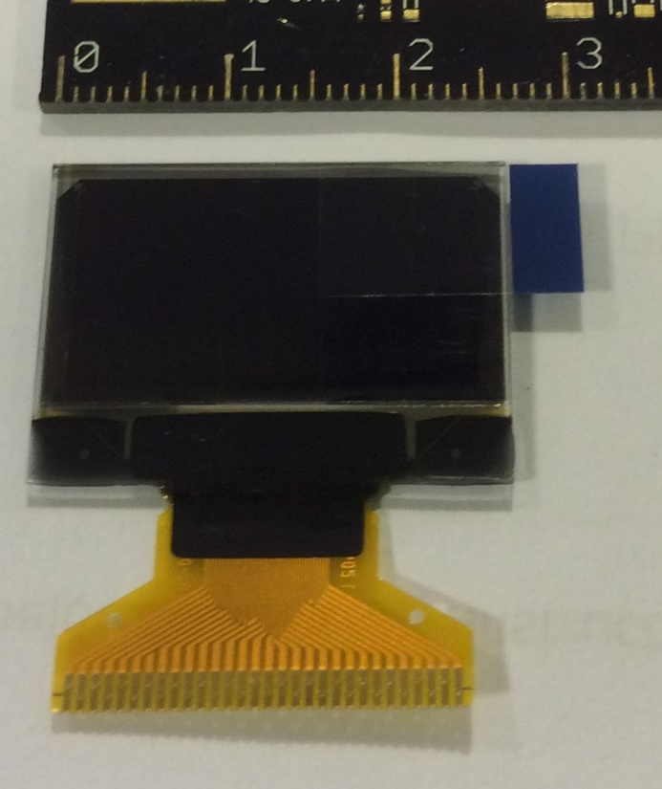
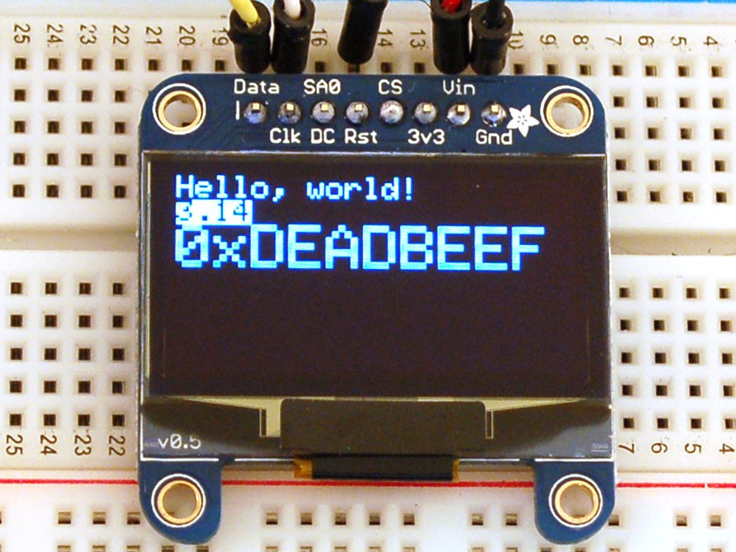
OLED screen
3cm x 1.5cm
128 x 64 pixels. 0.96” diagonal
Univision Technology UG-2864HSWEG01

Slide 22
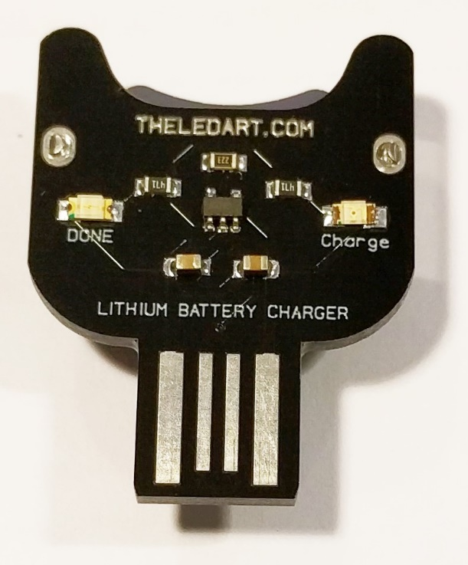
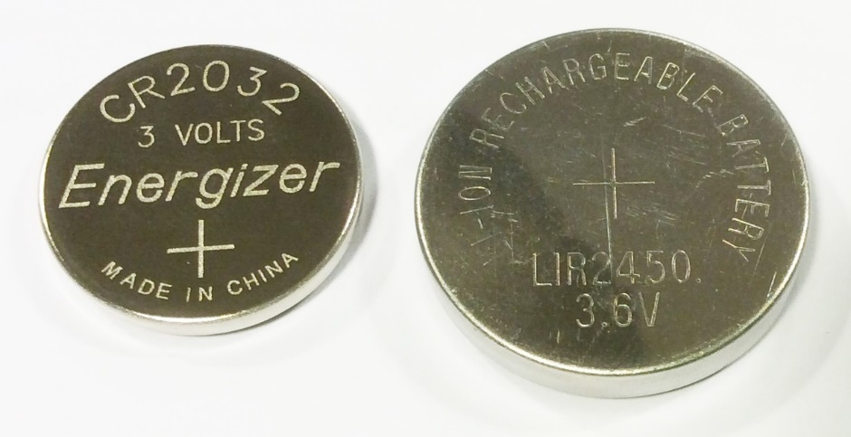
Power source
LIR2450 rechargeable cell
3.6V 120mAh
24.5mm x 5mm
LIR2450 charger
By: theledart
Based on MCP73831

Slide 23
It's easier to ask forgiveness than it is to get permission. (Grace Hopper, 1986)
By: Yeo Kheng Meng (yeokm1@gmail.com)
https://github.com/yeokm1/pcb-name-card-sp

